Slide 1
NEO4J CYPHER TUTORIAL WITH PYTHON
Advanced Opeartion With Json Data Using Neo4j Cypher ,Apoc & Python
Tutorial 83

Slide 2
Sample json data
{name: "DS101", subjects: ["coding", "data_structure", "algorithm"], duration: 1}
{name: "DS102", subjects: ["coding", "data_structure", "algorithm","system_design"], duration: 2}
{name: "DS103", subjects: ["coding", "data_structure", "algorithm","system_design","problem_solving"], duration: 3}

Slide 3
Use case
Advanced operations with json data using apoc procedure

Slide 4
Pre-requisites
apoc.import.file.enabled=true
apoc.import.file.use_neo4j_config=false

Slide 5
Find out the number of subjects per exam , and subjects should be included in list
code
call apoc.load.json("file:///users/roni/data/sample.json")
yield value
with value
return value.name as Exam_Name,value.subjects as Subjects,size(value.subjects) as No_Of_Subjects

Slide 6
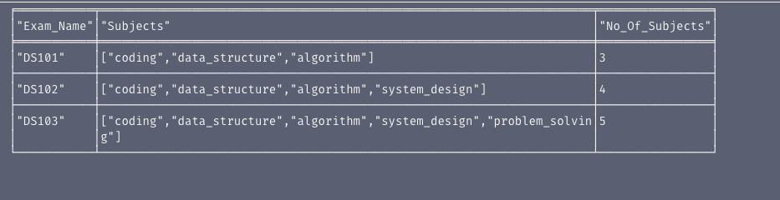
output
From neo4j browser

Slide 7
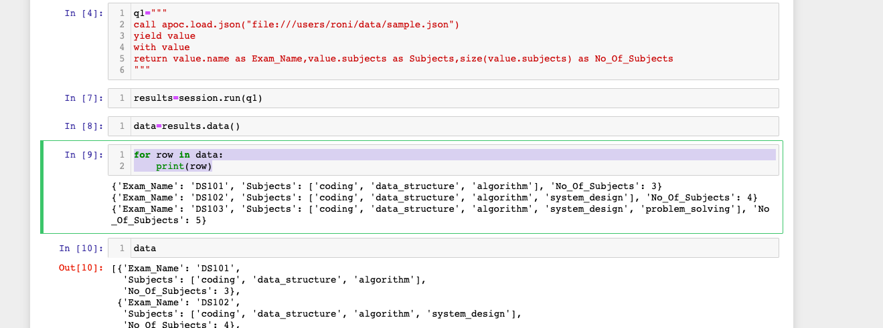
Python code
How to read json file full code

Slide 8
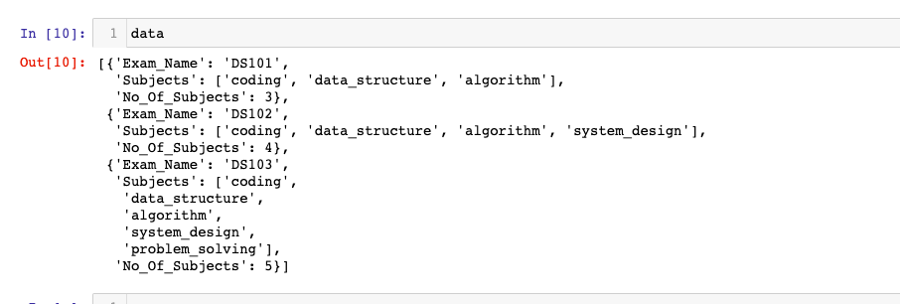
output
From neo4j browser

